Slide 1
Week 2
Computer Vision

Slide 2
What we have learned in this week’s videos?
CNN Architectures
CPU vs GPU
Transfer learning

Slide 3
Session agenda
CNN Architectures
Spectrum of depth
Network in network
Transfer learning
Case study
Questions

Slide 4
CNN Architectures

Slide 5
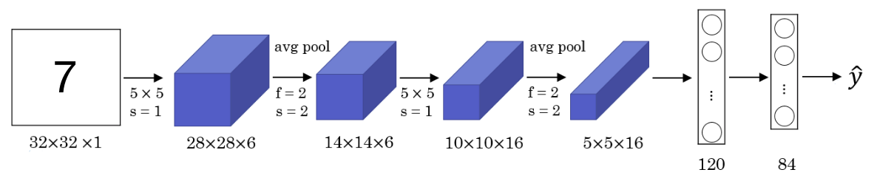
LeNet-5
The goal for this model was to identify handwritten digits in a 32x32x1 gray image.
This model was published in 1998. The last layer wasn't using softmax back then.
It has 60k parameters.
The dimensions of the image decreases as the number of channels increases.
Conv ==> Pool ==> Conv ==> Pool ==> FC ==> FC ==> softmax this type of arrangement is quite common.
The activation function used in the paper was Sigmoid and Tanh. Modern implementation uses RELU in most of the cases.
Paper source: stanford.edu

Slide 6
LeNet
10 way neural network classifier
Handwritten digits as an input
Tolerant of various transformations like rotation and scale
Was used by banks to recognize handwritten numbers on digitized checks
4 weight layers

Slide 7
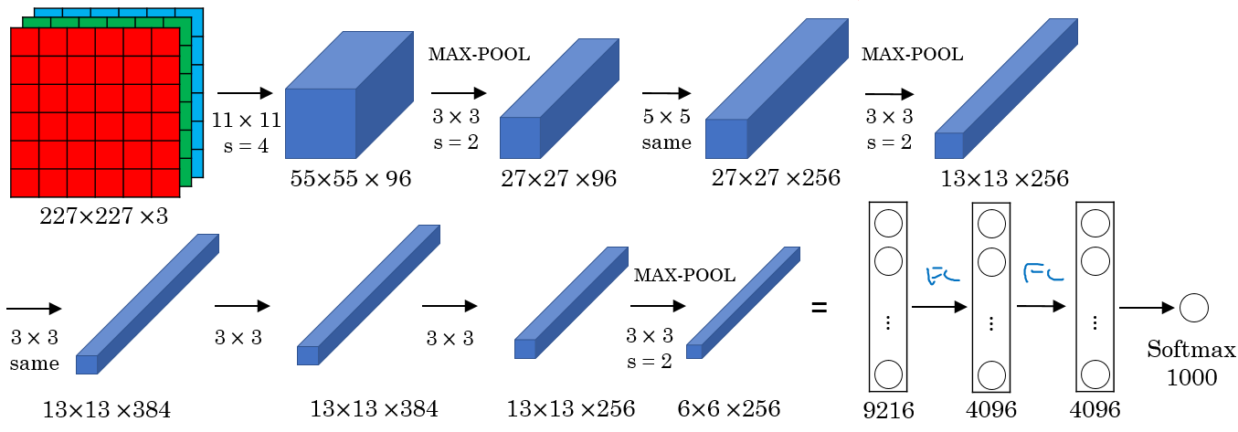
AlexNet
The goal for the model was the ImageNet challenge which classifies images into 1000 classes.
Has 60 Million parameter compared to 60k parameter of LeNet-5.
It used the RELU activation function.
This paper convinced the computer vision researchers that deep learning is so important.
Conv => Max-pool => Conv => Max-pool => Conv => Conv => Conv => Max-pool ==> Flatten ==> FC ==> FC ==> Softmax

Slide 8
AlexNet
Input Image
Conv + MaxPool + ReLU
Conv + MaxPool + ReLU
Conv + MaxPool + ReLU
Conv + MaxPool + ReLU
Output
Fully Connected
Fully Connected
Flatten
1000x1

Slide 9
What made AlexNet successful?
AlexNet architecture
Deep dive block by block
Overlapping max pooling
ReLu
Dropouts
Cropping
Data Augmentation
Inference Augmentation

Slide 10
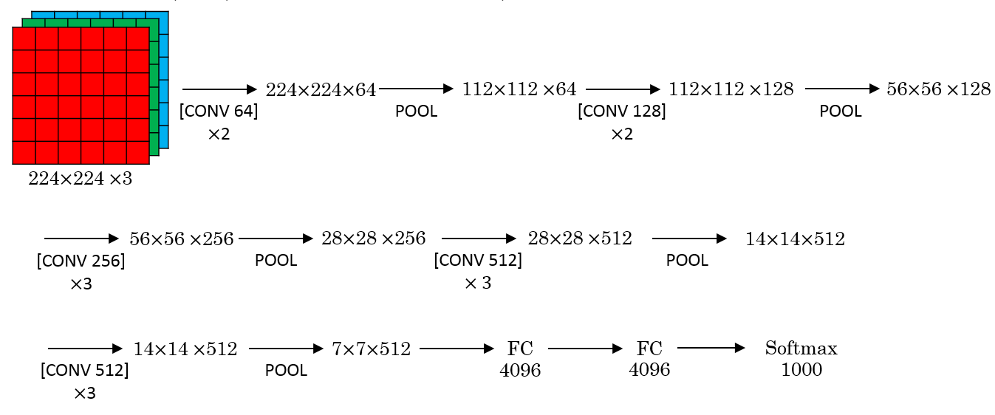
VGG-16
A modification for AlexNet.
Instead of having a lot of hyperparameters lets have some simpler network.
Focus on having only these blocks:
CONV = 3 X 3 filter, s = 1, same
MAX-POOL = 2 X 2 , s = 2

Slide 11
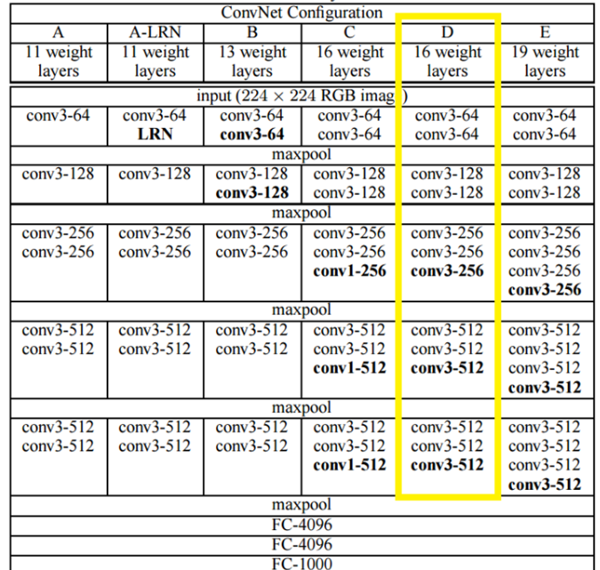
Different VGG architectures
Architectures used in the VGG work

Slide 12
VGG-16
This network is large even by modern standards. It has around 138 million parameters.
Most of the parameters are in the fully connected layers.
It has a total memory of 96MB per image for only forward propagation!
Most memory are in the earlier layers.
Number of filters increases from 64 to 128 to 256 to 512. 512 was made twice.
Pooling was the only one who is responsible for shrinking the dimensions.
There are another version called VGG-19 which is a bigger version. But most people uses the VGG-16 instead of the VGG-19 because it does the same.
VGG paper is attractive it tries to make some rules regarding using CNNs.
https://arxiv.org/abs/1409.1556

Slide 13
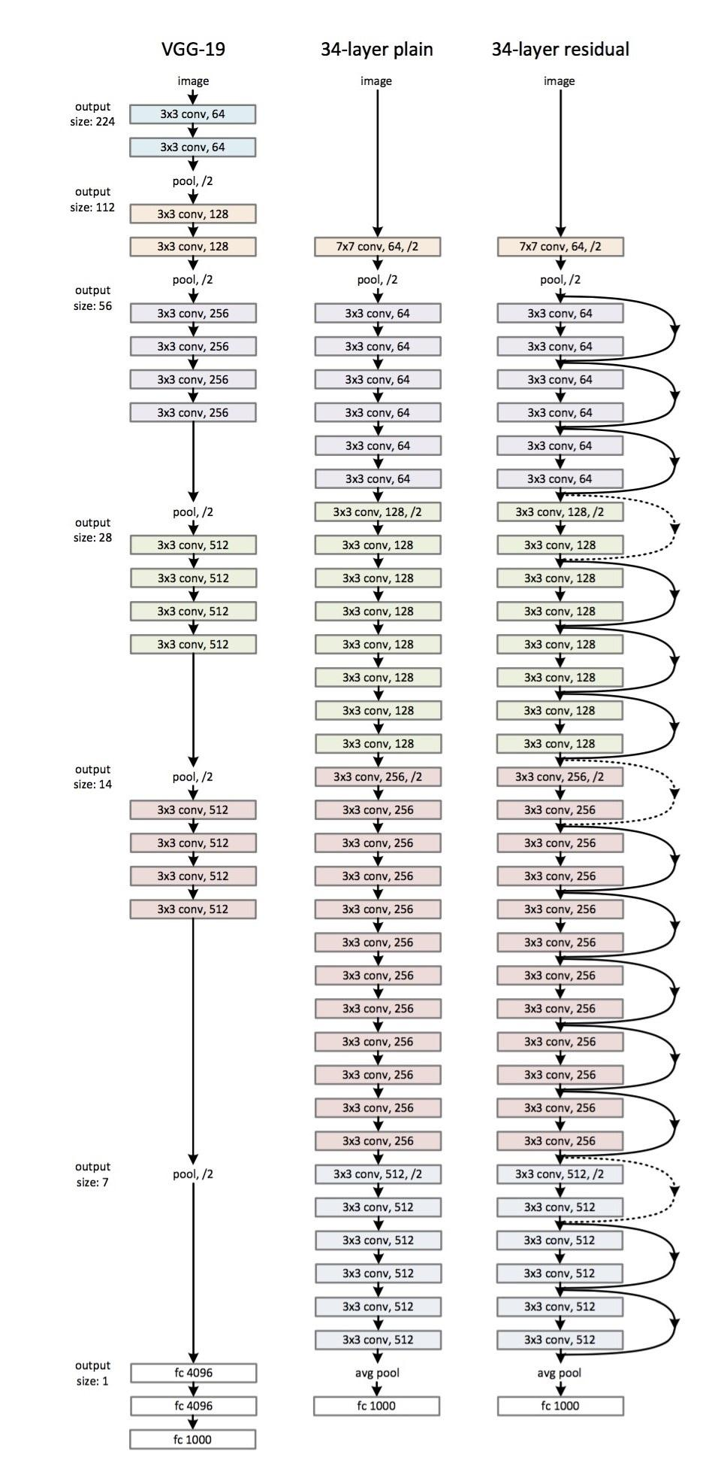
Residual Networks (ResNets)
Very, very deep NNs are difficult to train because of vanishing and exploding gradients problems.
In this section we will learn about skip connection which makes you take the activation from one layer and suddenly feed it to another layer even much deeper in NN which allows you to train large NNs even with layers greater than 100.
Residual block
ResNets are built out of some Residual blocks.
They add a shortcut/skip connection before the second activation.
The authors of this block find that you can train a deeper NNs using stacking this block.
Residual Network
Are a NN that consists of some Residual blocks.
These networks can go deeper without hurting the performance. In the normal NN - Plain networks - the theory tell us that if we go deeper we will get a better solution to our problem, but because of the vanishing and exploding gradients problems the performance of the network suffers as it goes deeper.

Slide 14
ResNet-34
The architecture of ResNet-34
All the 3x3 Conv are same Convs.
Keep it simple in design of the network.
spatial size /2 => # filters x2
No FC layers, No dropout is used.
Two main types of blocks are used in a ResNet, depending mainly on whether the input/output dimensions are same or different. You are going to implement both of them.
The dotted lines is the case when the dimensions are different. To solve then they down-sample the input by 2 and then pad zeros to match the two dimensions. There's another trick which is called bottleneck.

Slide 15
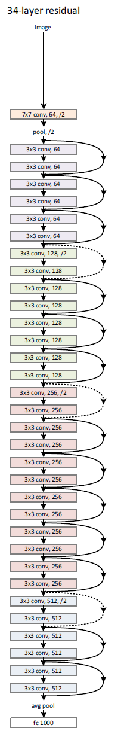
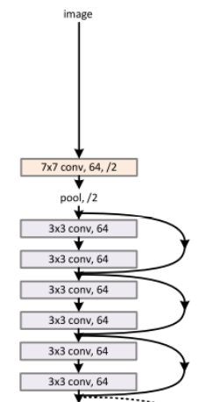
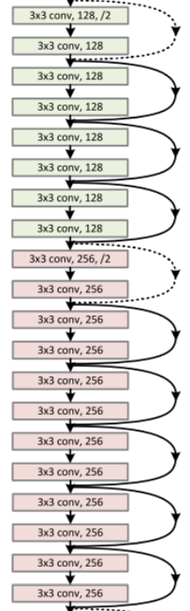
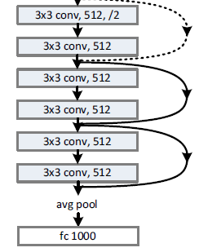
Basic architecture: ResNet-34

Slide 16
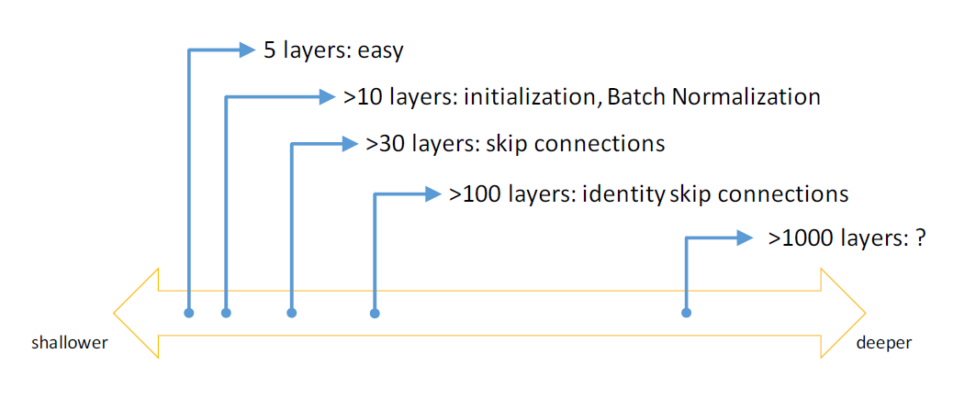
Spectrum of depth
Image source: icml.cc

Slide 17
Network in network & 1 x 1 convolutions
A 1 x 1 convolution - We also call it Network in Network- is so useful in many CNN models.
It has been used in a lot of modern CNN implementations like ResNet and Inception models.
A 1 x 1 convolution is useful when:
We want to shrink the number of channels. We also call this feature transformation. Shrinking can save a lot of computations.
If we have specified the number of 1 x 1 Conv filters to be the same as the input number of channels then the output will contain the same number of channels. Then the 1 x 1 Conv will act like a non linearity and will learn non linearity operator.

Slide 18
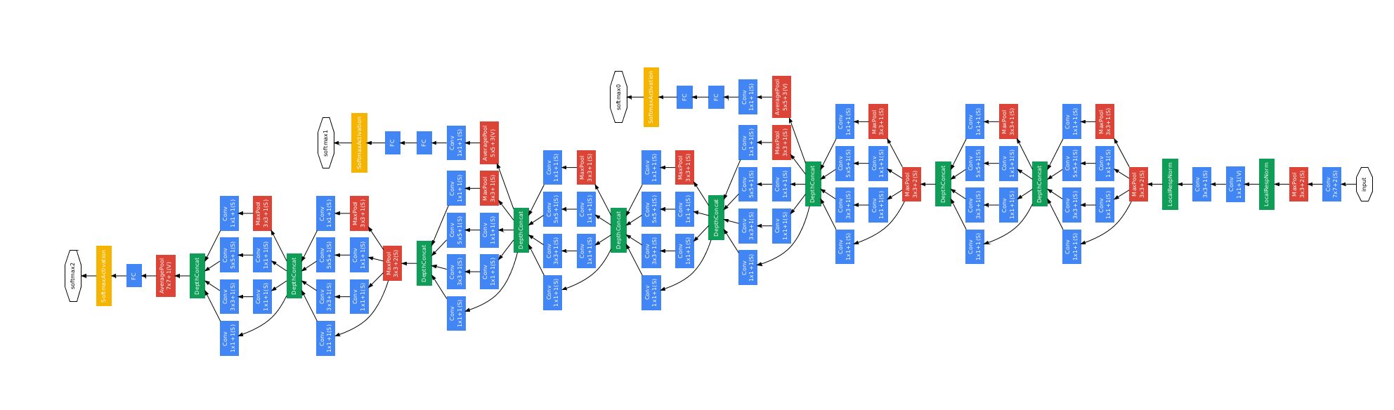
Inception network (GoogleNet)
The inception network consist of concatenated blocks of the Inception module.
The name inception was taken from a meme image which was taken from Inception movie.
Some times a Max-Pool block is used before the inception module to reduce the dimensions of the inputs.
There are a 3 Sofmax branches at different positions to push the network toward its goal. and helps to ensure that the intermediate features are good enough to the network to learn and it turns out that softmax0 and sofmax1 gives regularization effect.

Slide 19
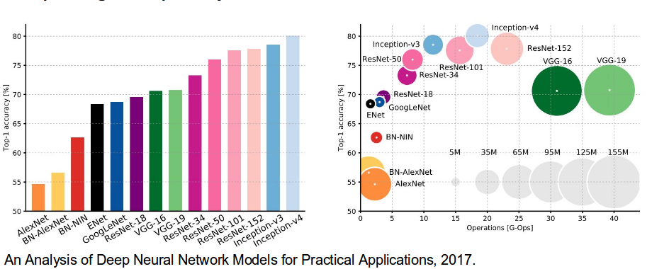
State of the art CNN architectures

Slide 20
Transfer learning

Slide 21
Transfer learning
If you are using a specific NN architecture that has been trained before, you can use this pretrained parameters/weights instead of random initialization to solve your problem.
It can help you boost the performance of the NN.
The pretrained models might have trained on a large datasets like ImageNet, Ms COCO, or pascal and took a lot of time to learn those parameters/weights with optimized hyperparameters. This can save you a lot of time.
If you have enough data, you can fine tune all the layers in your pretrained network but don't random initialize the parameters, leave the learned parameters as it is and learn from there.

Slide 22
Why transfer learning?
Given a new application, one looks at opportunities for re-using knowledge (e.g. architectures and weights) from similar learning problems which were trained with large amounts of data
Transfer Learning!
Humans are great at transfer learning
(e.g. Bicycle bike, Tennis, Badminton, Language skills)

Slide 23
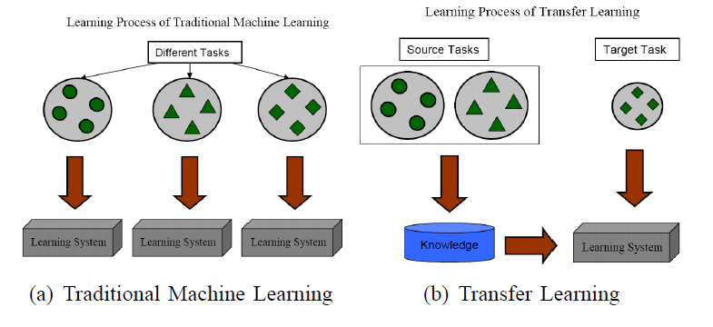
Transfer learning: how it works?

Slide 24
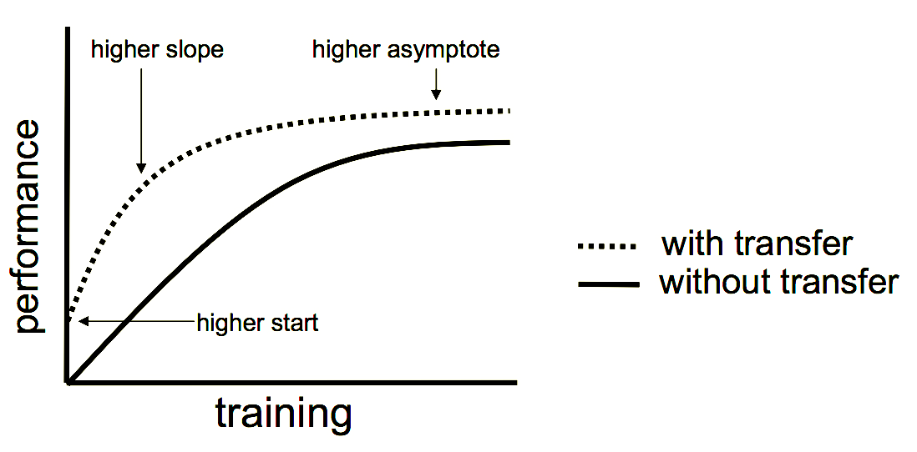
Advantages of transfer learning

Slide 25


AIML @WORK
PGPAIML @ Great Learning
Enabling Learners to Apply the AI/ML Concepts at Work
Apply AIML at your workplace to gain some instant benefits:
Get noticed by your management with your outstanding analysis backed by data science.
Create an impact in your organization by taking up small projects/initiatives to solve critical issues using data science.
Network with members from the data science vertical of your organization and seek opportunities to contribute in small projects.
Share your success stories with us and the world to position yourself as a subject matter expert in data science.
AIML Operations | AIMLAW
@Great Learning Proprietary Content. All rights reserved. Unauthorized use or distribution prohibited

Slide 26
Summary

Slide 27
Summary
We learned about various CNN Architectures.
LeNet, AlexNet, ResNet, GoogleNet.
We now know what is spectrum of depth.
Network in network and 1 x 1 convolutions.
We learned about transfer learning and it’s applications.

